Slide 1



overall_1_132573879104528179 columns_1_132573879104528179
Microsoft Office Add-ins
Community call
Deploy Office Add-ins using SSO
Feedback for WXP
Prepend on Send
January 11, 2023

Slide 2


Agenda
David Chesnut
Yun Wang
Yashvardhan Joshi
Senior Technical Writer
Principal Product Manager
Senior Product Manager

Slide 3
Deploy Offfice Add-in using SSO
David Chesnut: Senior Technical Writer

Slide 4

Feedback for WXP
Yun Wang: Principal Product Manager

Slide 5
Existing surveys for Word, Excel and PowerPoint extensibility
Your inputs will help us to better prioritize the work!
Auto install and auto launch add-ins for Word, Excel and PowerPoint
https://aka.ms/addin-auto-open
Will have survey result sharing in upcoming community calls
Structured document content usage in Word add-ins
Survey for Content Controls and Fields related requirements
https://aka.ms/WordAPI

Slide 6
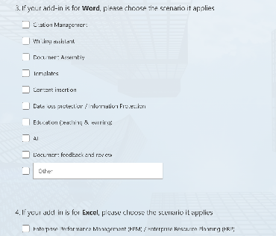

A new survey
Tell us about your user scenarios of Word, Excel or PowerPoint add-in
https://aka.ms/office-user-scenarios

Slide 7

Prepend Onsend
Yashvardhan Joshi: Senior Product Manager

Slide 8
Prepend on Send API
Post the launch of the append on send scenario, a key add-in ask remains - the prepend on send API.
Prepend on send can insert disclaimer or other content at the beginning of mail/event when it's sent out
These can be plain text or HTML supporting
Work cross platform
Support inline images
Work without changes in permission if you support append on send

Slide 9

Instances on how this will be useful

Slide 10
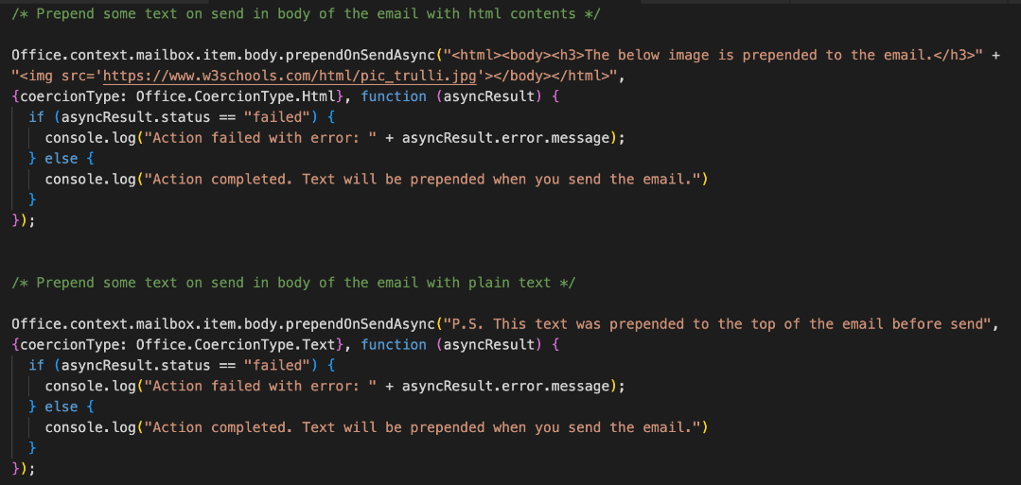
API Details

Slide 11
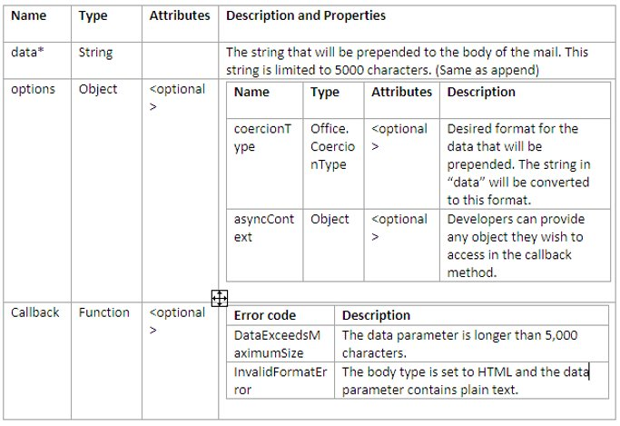
API Parameters

Slide 12
Manifest changes
<ExtendedPermissions >
<ExtendedPermission> AppendOnSend <ExtendedPermission/>
<ExtendedPermission>SomeFeature1<ExtendedPermission/>
</ ExtendedPermissions>
These are the same extended permissions for Append on send as well

Slide 13
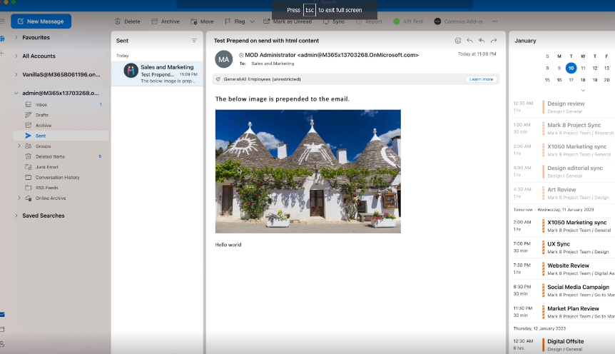
Demo Video

Slide 14
Public documentation
Snippet: office-js-snippets/prepend-text-on-send.yaml at main · OfficeDev/office-js-snippets (github.com)
API: Office.Body interface - Office Add-ins | Microsoft Learn
Outlook preview API: https://aka.ms/OutlookPreviewAPI

Slide 15
Question:
Outlook Mobile (on iOS and Android) still only generally supports message read mode. When is compose mode and the on-send event, going to be supported? This feature difference between the Outlook variants has been present for many years and remains a major barrier to customer adoption of our Outlook add-in. It is an open 'issue' in github - https://github.com/OfficeDev/office-js/issues/1455 - and was a very highly requested feature when uservoice was used to lodge such.
Answer:
We currently do not have a roadmap for this feature, but it would be great if you could submit a feature request here: https://aka.ms/m365dev-suggestions and provide more details about your add-in and your exact requirements for compose on Mobile.
Q&A

Slide 16
Question:
1) We would like to enter our Outlook add-in into AppSource, but it is blocked because it is an on-send add-in. When will AppSource accept on-send add-ins?
2) What is the roadmap regarding adding on-send functionality to phones (both iPhone and Android)?
Answer:
This is still not allowed. We recently shipped Smart alerts, is the relatively the same functionality and it’s allowed in the store. Check details here: https://learn.microsoft.com/en-us/office/dev/add-ins/outlook/smart-alerts-onmessagesend-walkthrough?tabs=xmlmanifest please note that SendMode=Block is still not allowed in the store.
Q&A

Slide 17
Question:
What is the timeline for upcoming features in PowerPoint? There’s a lot in excel but can’t be done in word or PowerPoint.
The developer feedback and ideas forum doesn’t get much attention. Could there be more effort in this review?
Answer:
This will be answered in the blog post.
Q&A

Slide 18
Question:
Is there a timeline for when Outlook Mobile (on iOS and Android) will support compose mode for Office add-ins, and further when the on-send event will be supported? Currently only read-mode is supported for Outlook add-ins and this has been the state for many years now, but our add-in is essentially for compliance measures to ensure all sent messages include some extra input/metadata from the sender.
Answer:
We have been getting questions on on-send support for mobile quite frequently now. This feature will be looked into once we are able to finish delivering other features that on-send would build upon.
Q&A

Slide 19
Question:
Is there an API or access point where we can call how many seats have been provisioned for an Office Add-in by the 365 Administrator? Say a company has 25 seats but authorizes only 5 for my add-in - is there a way for the add-in developer to know that? Please note that we do not have a SaaS application, just an Office Store add-in.
Answer:
Will be answered in blog post.
Q&A

Slide 20






New to Office Add-ins?
 | Documentation | https://aka.ms/office-add-ins-docs
 | Quick starts | Outlook, Excel, Word, PowerPoint
 | Script Lab | https://aka.ms/getscriptlab
 | Samples | https://aka.ms/officeaddinsamples
 | Microsoft 365 Developer Program | https://aka.ms/M365devprogram
 | Office Scripts | aka.ms/office-scripts-docs
Notes:
m365-dev-sig

Slide 21
Engage with the team
Engagement | Where to go
Technical questions about Office Add-ins | https://aka.ms/office-addins-dev-questions [office-js-dev] [office-addins-dev] https://stackoverflow.com [office-js] [outlook-web-addins] [office-scripts]
Product bugs | https://github.com/OfficeDev/office-js
Feature requests and ideas | https://aka.ms/m365dev-suggestions
Send a Smile or Frown | Inside Office
Notes:
m365-dev-sig

Slide 22
Microsoft 365 developer community calls
Microsoft 365 platform call (weekly) https://aka.ms/m365-dev-call
Microsoft 365 & Power Platform Development (bi-weekly) https://aka.ms/m365-dev-sig
Viva Connections &
SharePoint Framework (bi-weekly) https://aka.ms/spdev-spfx-call
Adaptive Cards (monthly) https://aka.ms/adaptivecardscommunitycall
Microsoft identity platform (monthly) https://aka.ms/IDDevCommunityCalendar
Office Add-ins (monthly) https://aka.ms/officeaddinscommunitycall
Power Platform (monthly) https://aka.ms/PowerPlatformMonthlyCall
All calls and assets: https://aka.ms/m365pnp
Notes:
m365-dev-sig

Slide 23
Thank you
Recording will be available in 24 hours on
Microsoft 365 Community (PnP) YouTube channel
https://aka.ms/M365PnP/videos
(subscribe today)
Follow us on Twitter
@Microsoft365Dev | @M365PnP
Next call: February 8th at 8:00 AM Pacific Time
https://aka.ms/officeaddinscommunitycall
Agenda: https://aka.ms/officeaddinsagenda
Submit your questions: https://aka.ms/officeaddinsform

